Slide 1
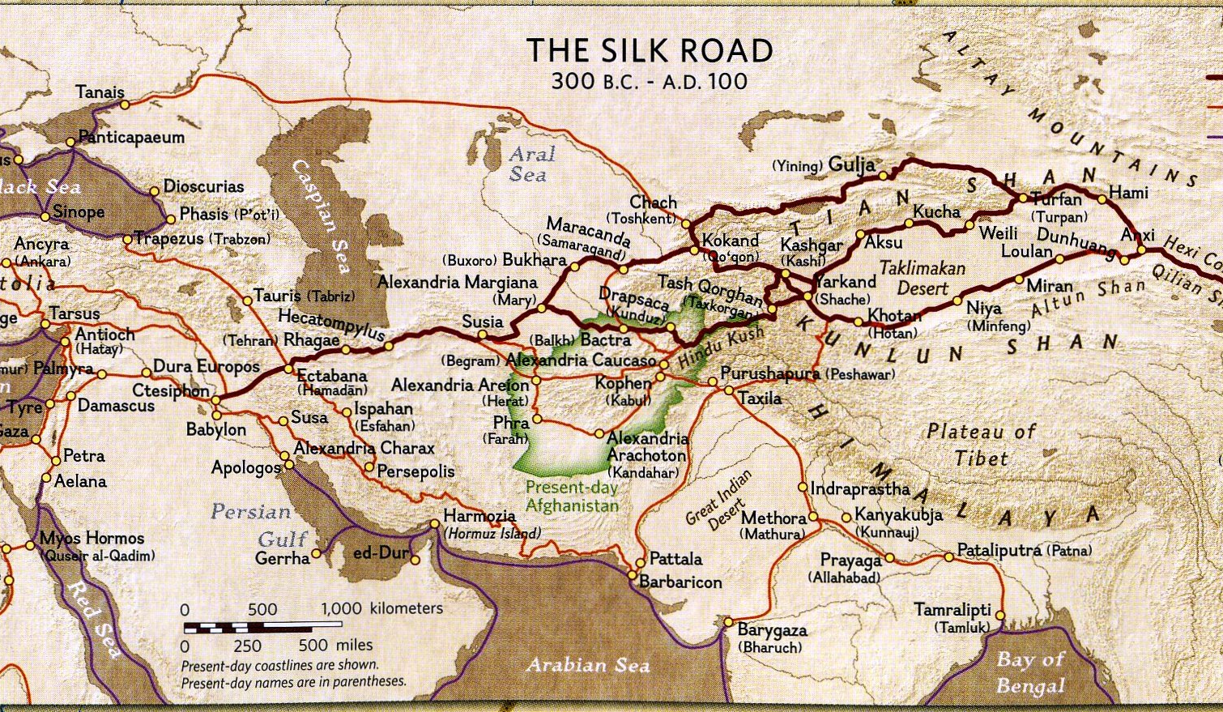
Class 24:
Silk Road
Cryptocurrency Café
UVa cs4501 Spring 2015
David Evans

Slide 2
Plan
Survey Responses
Wrap up:
Merged Mining
Sidechains
Legality of Bitcoin
Silk Road

Slide 3
Would you prefer to have project presentations spread over the last three classes (April 20, 22, and 27) or to use the allocated time for the final (Thursday, April 30, 2-5pm) for project presentations?
Presentations will start next week!
Schedule on course site now.

Slide 4
Should we have another quiz?
There won’t be a quiz for everyone. But, if you feel like you understand bitcoin better than is reflected by the previous quizzes, you should schedule an oral quiz.

Slide 5
Which topics that we have not yet covered should be covered in the remaining classes?
What did you hope we would do in this class that we haven't done yet?
14 | How the current financial infrastructure works
12 | Criminality
10 | Tor
9 | Anonymity with Bitcoin
8 | Blockchain Analysis
5 | Multiparty Computation
3 | Ethereum
2 | Turing Completeness
1 | Other: Sidechains

Slide 6
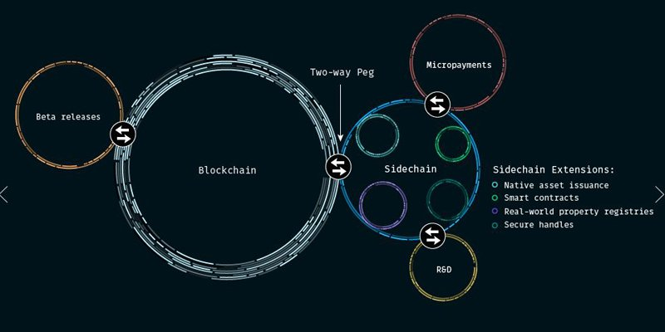
Sidechains

Slide 7
Why is it hard to evolve bitcoin?

Slide 8
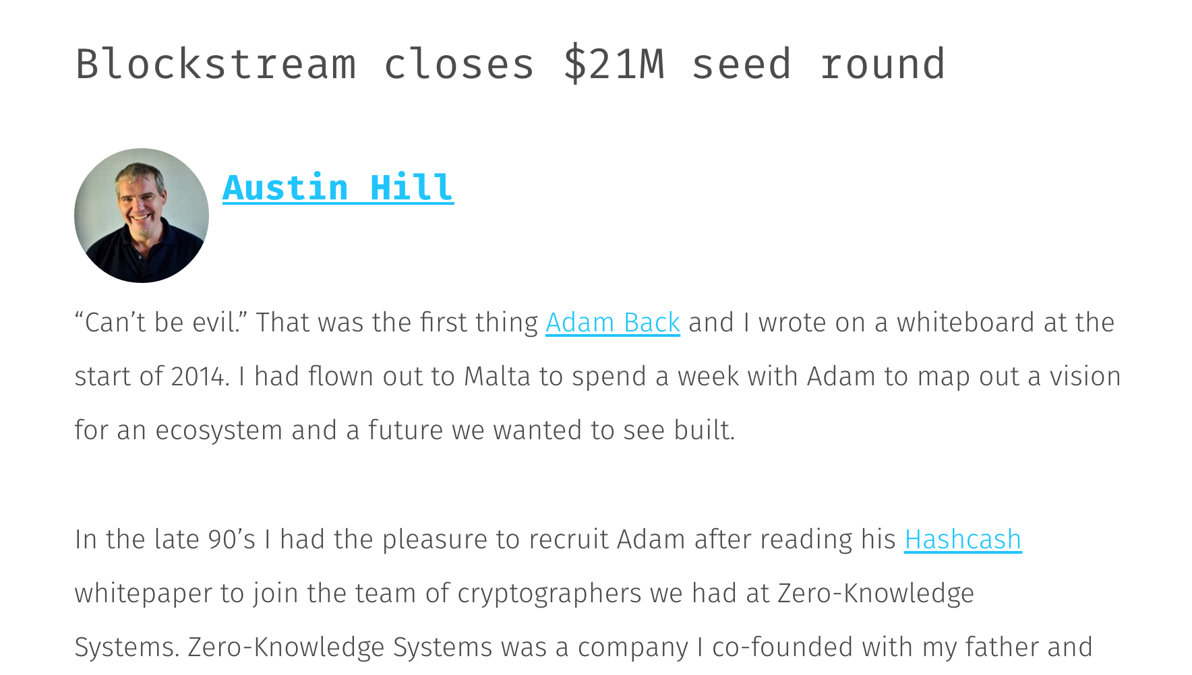
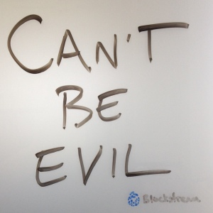

Slide 9
One-Way Peg
Main Chain
Bitcoin 351247
Bitcoin 351248
…
Bitcoin 372385
Transaction: “Proof of burn” for coin x
Proof: mint sidecoins
Sidecoin 0
Sidecoin 1
…
Sidecoin 1423

Slide 10
Two-Way Peg
Main Chain
Bitcoin 351247
Bitcoin 351248
…
Bitcoin 372385
Transaction: “Proof of freeze” for coin x
Transaction: “Proof of burn” in sidechain for coin x
Proof: mint sidecoins
Sidecoin 0
Sidecoin 1
…
Sidecoin 1423
Note: not possible without changing bitcoin

Slide 11
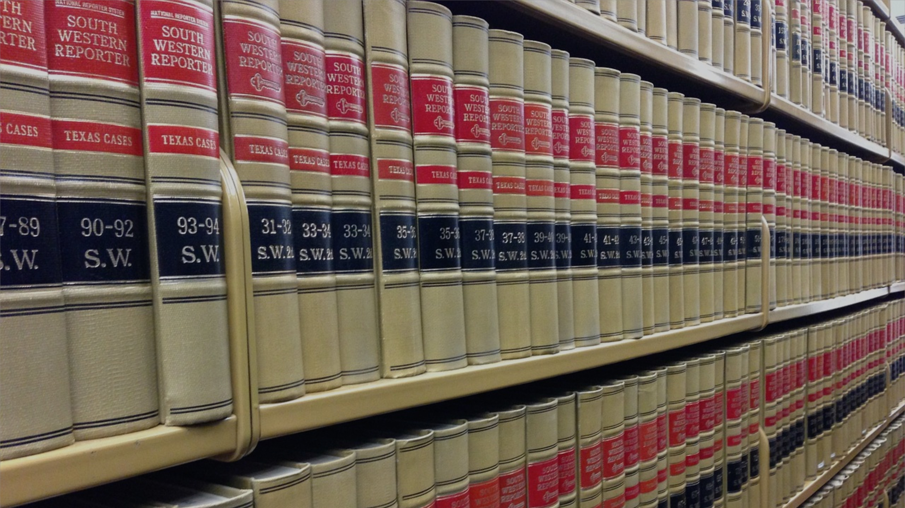
Legality of Bitcoin

Slide 12
Disclaimer: I am not a lawyer

Slide 13
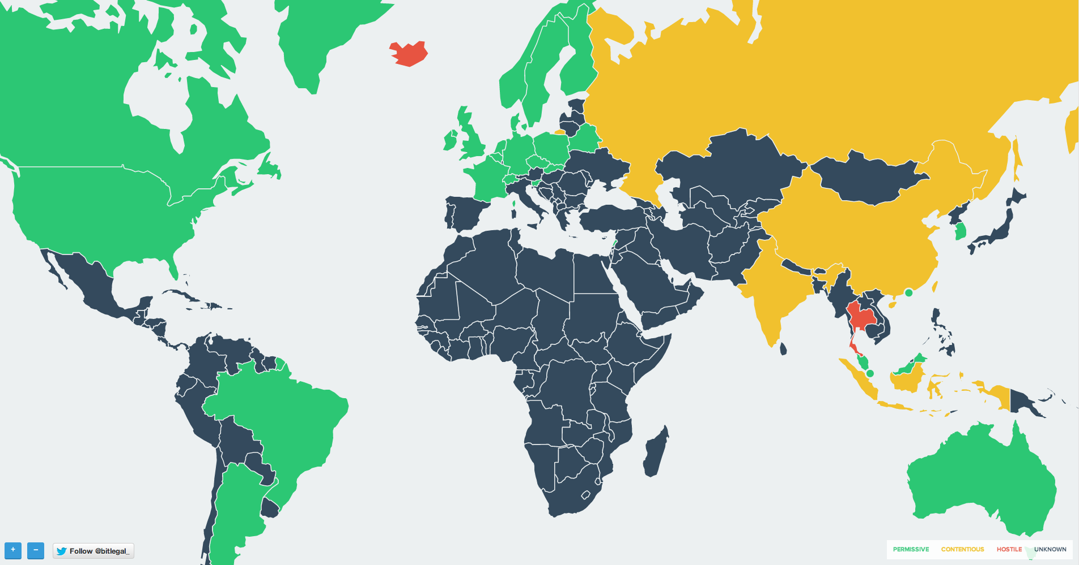
Jurisdiction
“Hostile”
“Contentious”
Legal
Unknown

Slide 14
Jurisdiction
“Hostile”
“Contentious”
Iceland:
Foreign Exchange Act
Prohibits buying/selling any foriegn currency
Legal
Unknown

Slide 15
Jurisdiction
“Hostile”
“Contentious”
Legal
Unknown
India: (probably illegal)
Raided bitcoin exchange as violating foreign exchange act

Slide 16
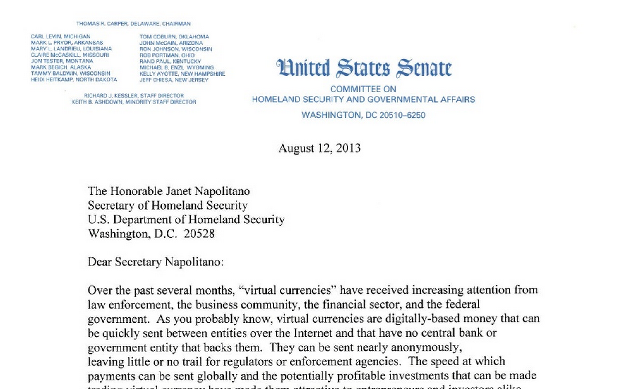

Slide 17
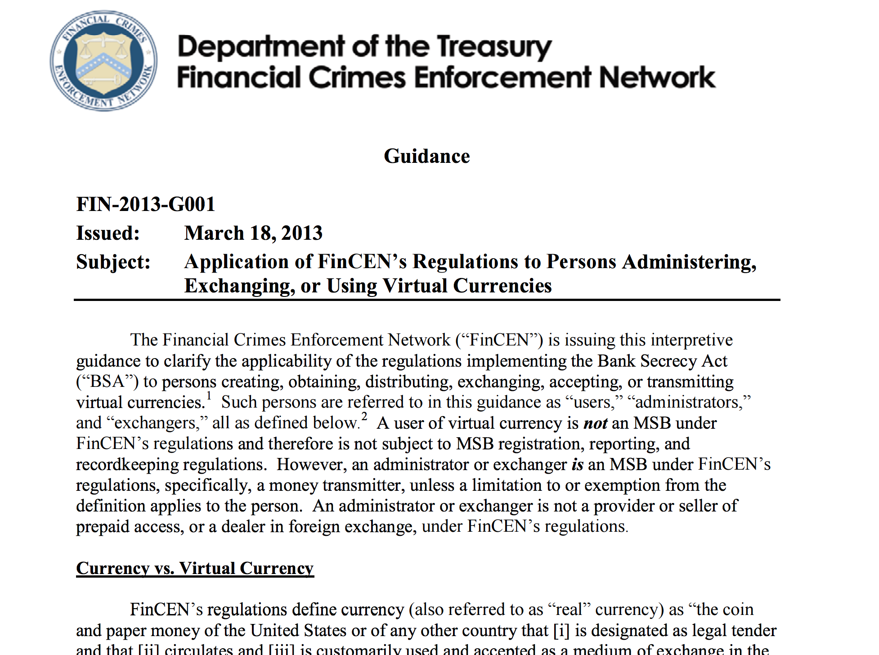

Slide 18
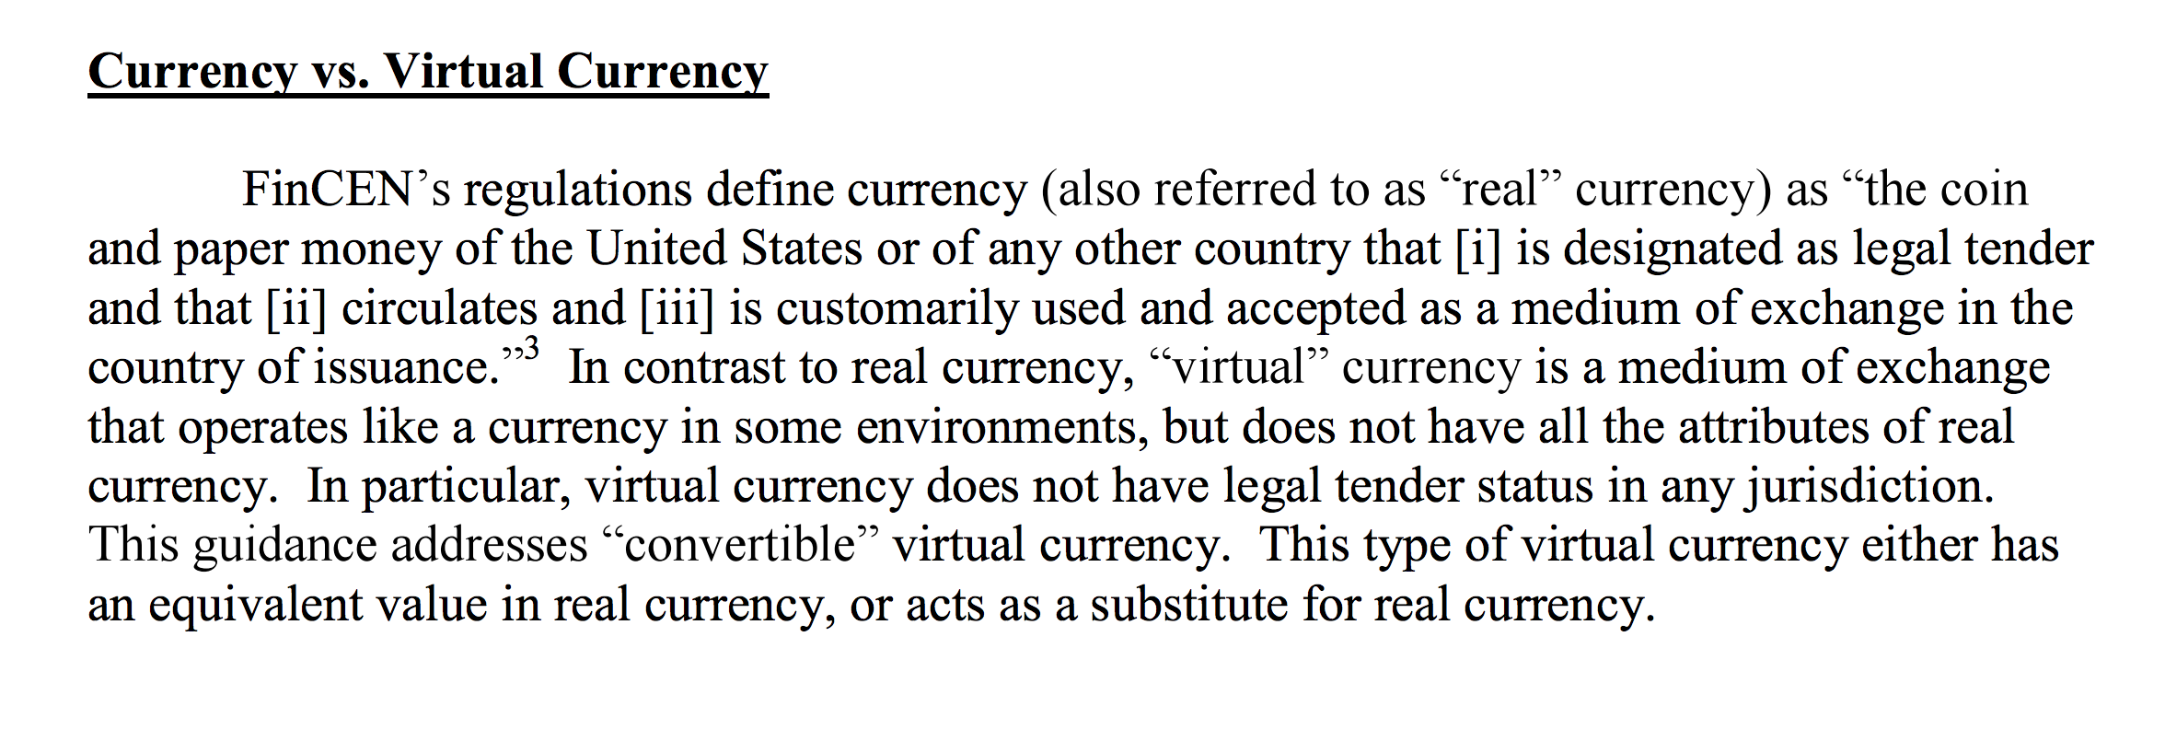

Slide 19
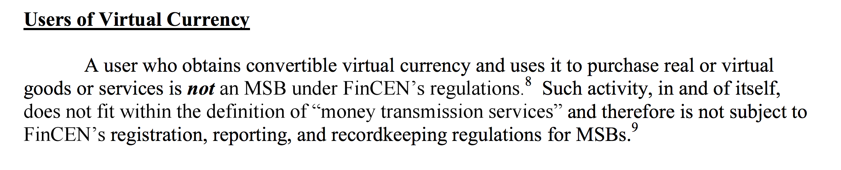
MSB: money services business

Slide 20
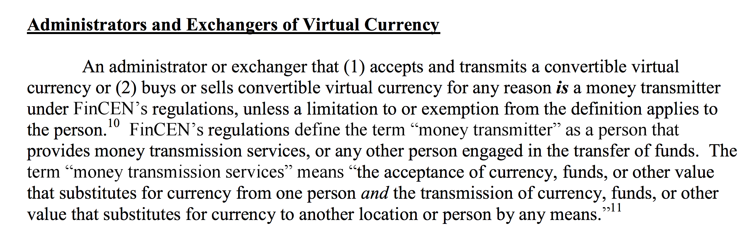
Did you/I violate the law by exchanging PointCoin for Pizza?

Slide 21
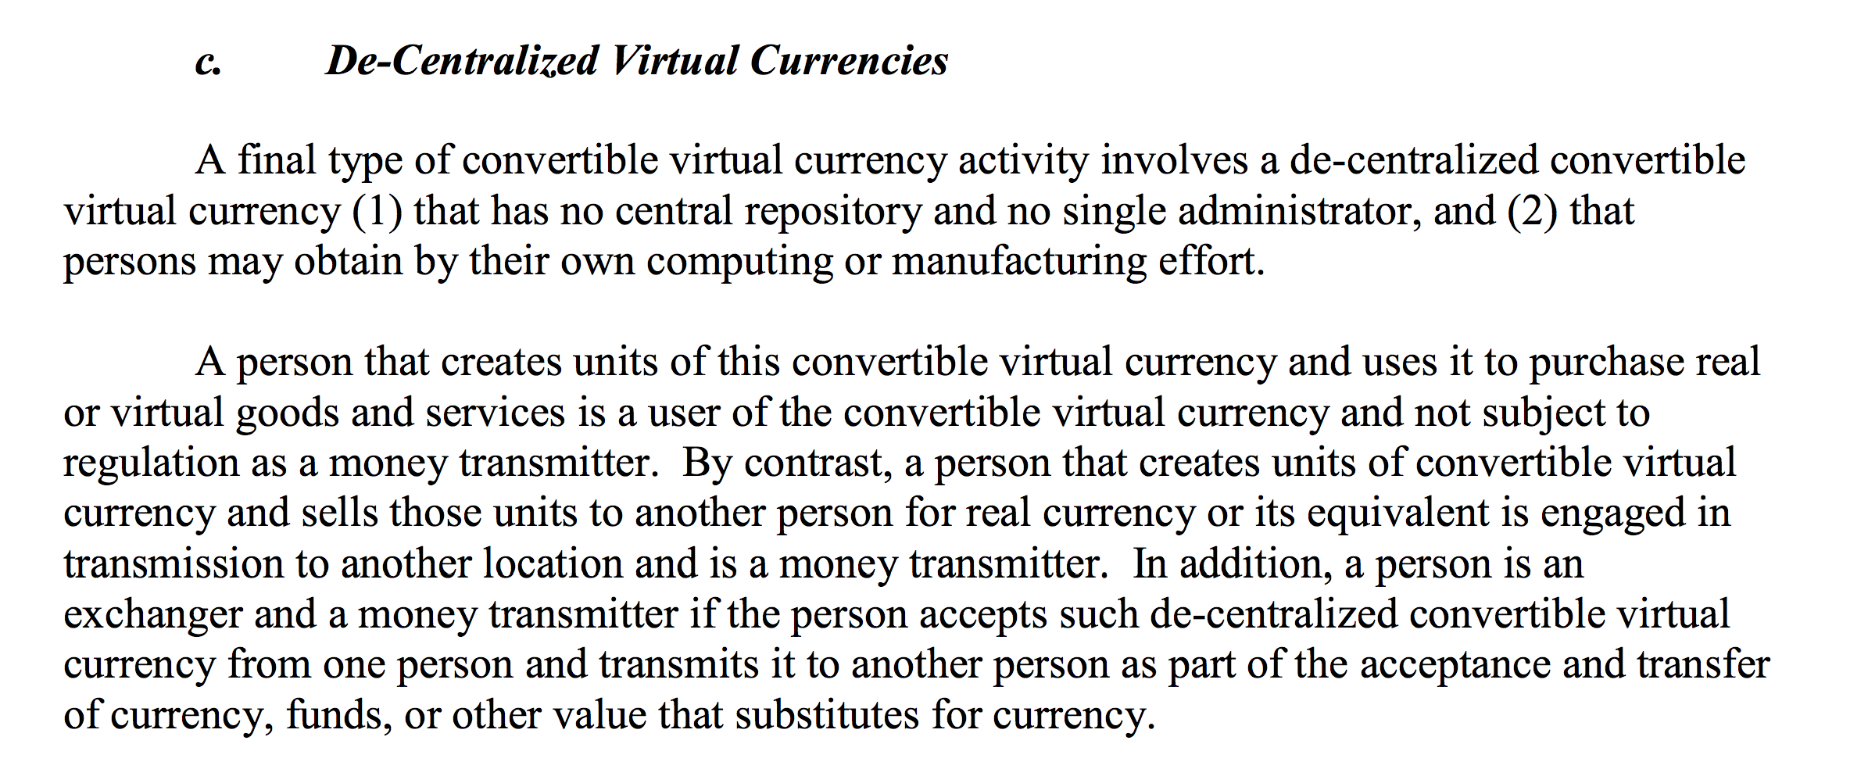

Slide 22
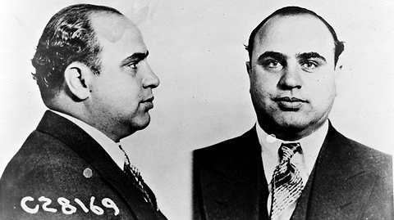
What about taxes?

Slide 23
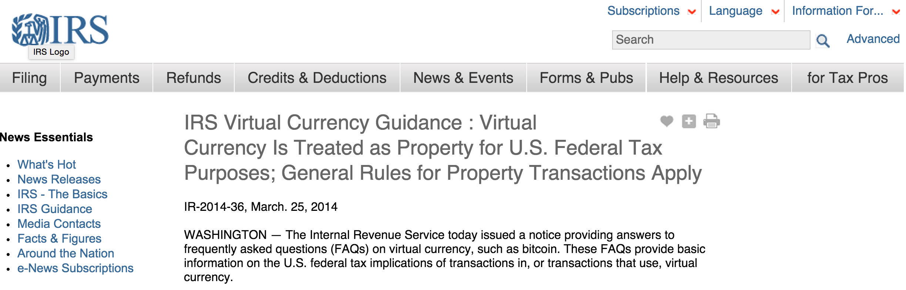

Slide 24
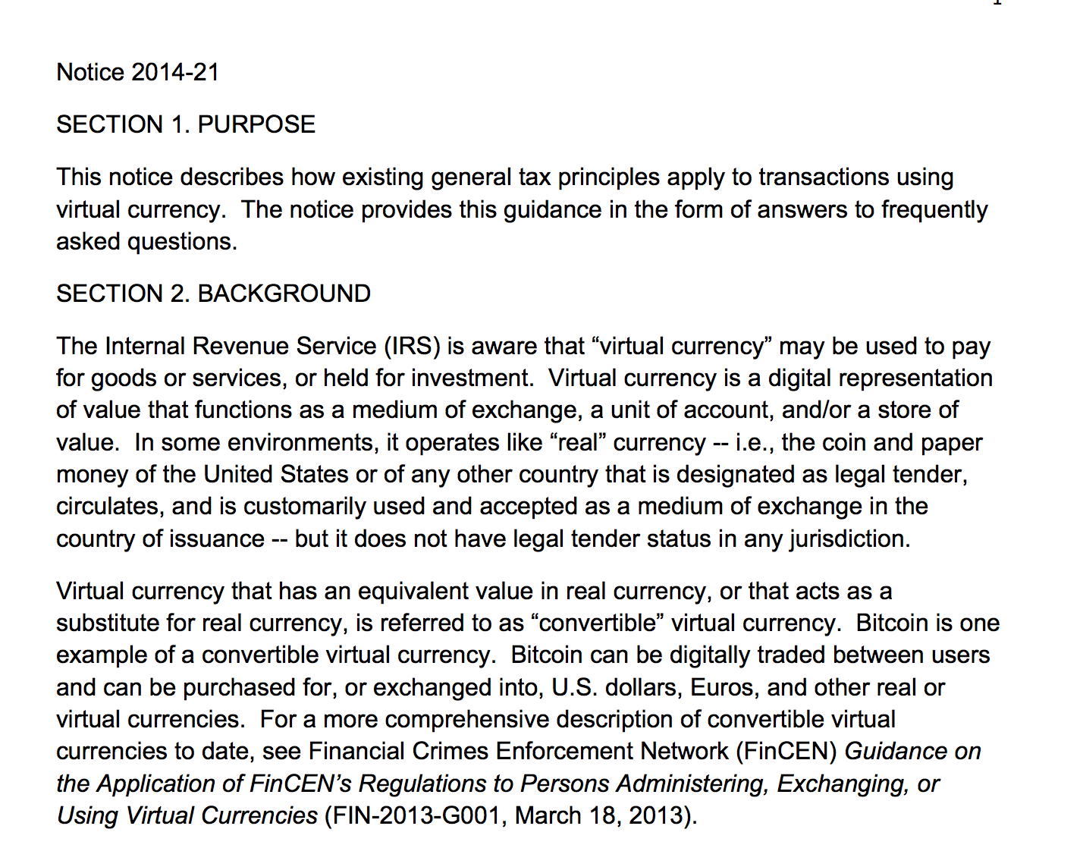

Slide 25
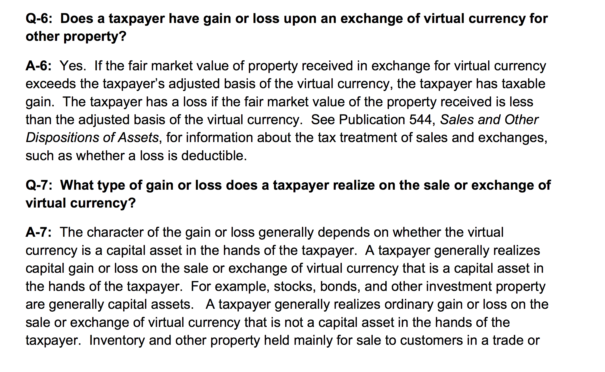

Slide 26
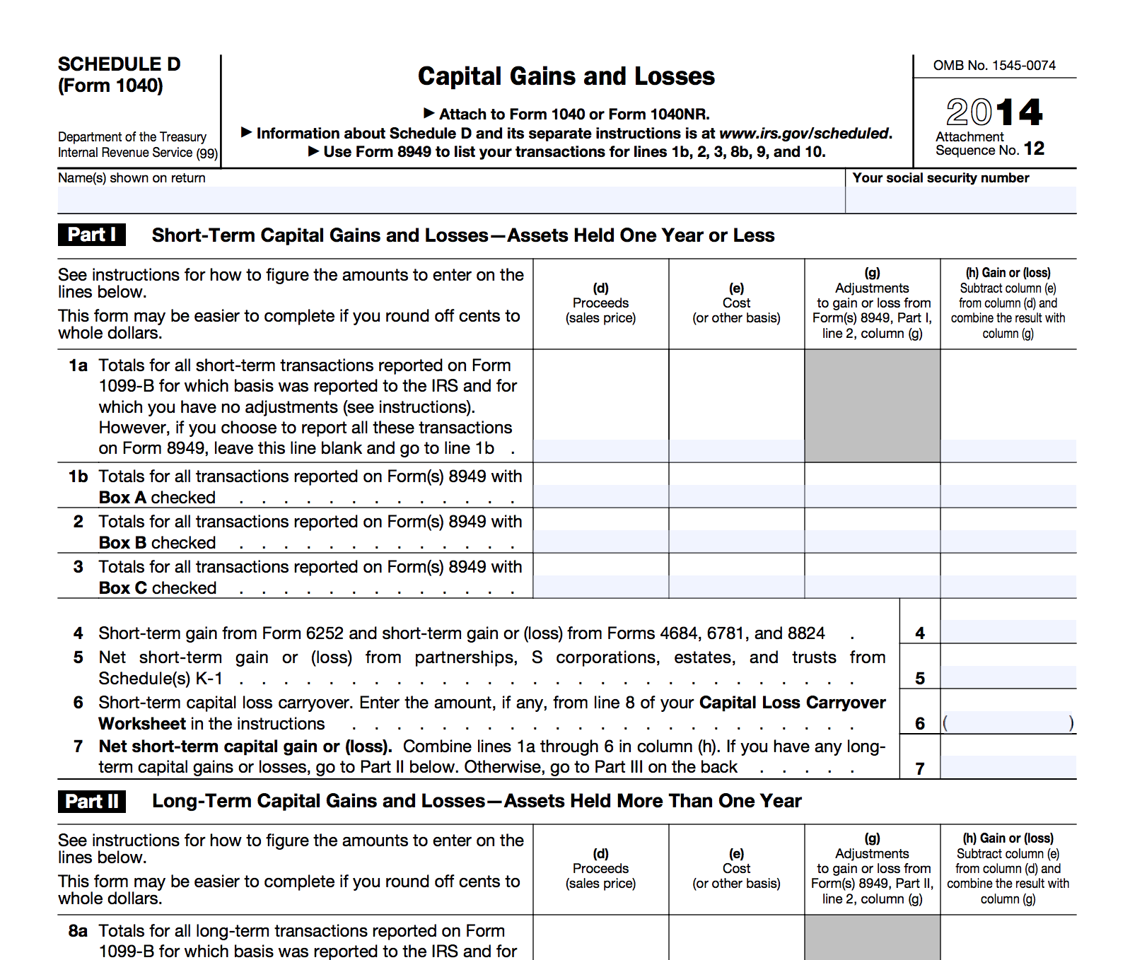
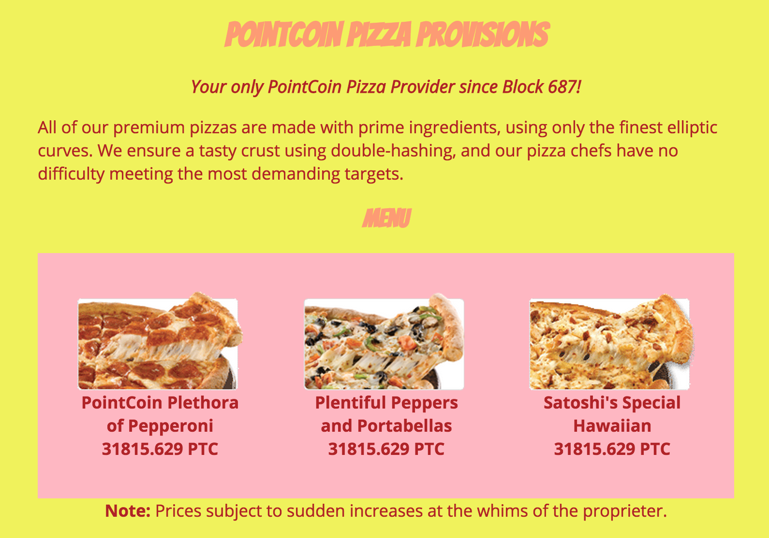

Slide 27
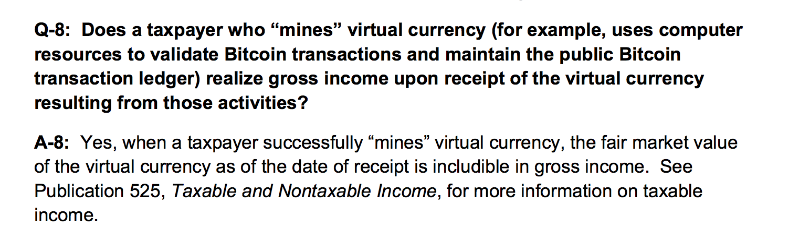
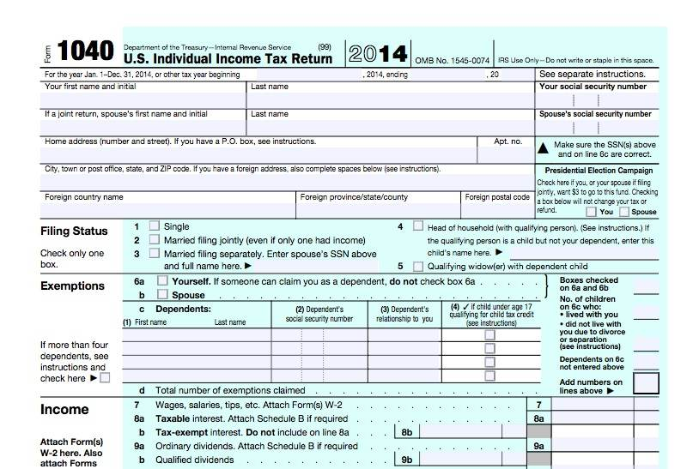

Slide 28
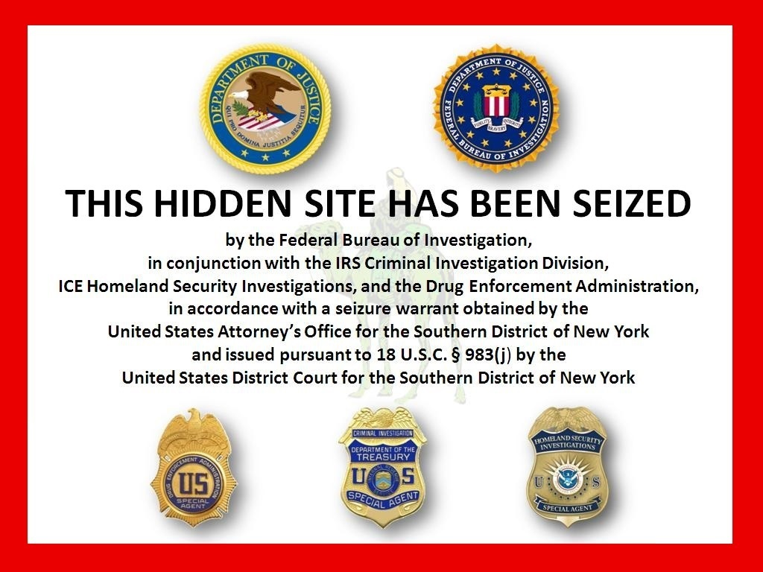
Silk Road

Slide 29
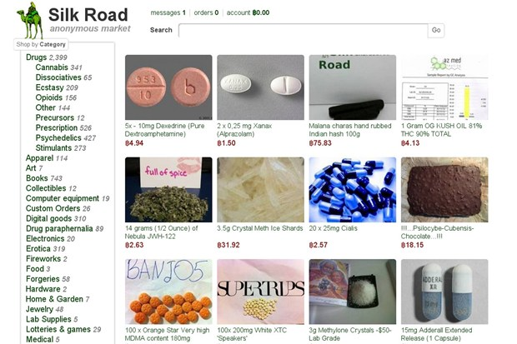

Slide 30
Illegal drugs are illegal and can rot your brain and destroy your (and others) lives!

Slide 31
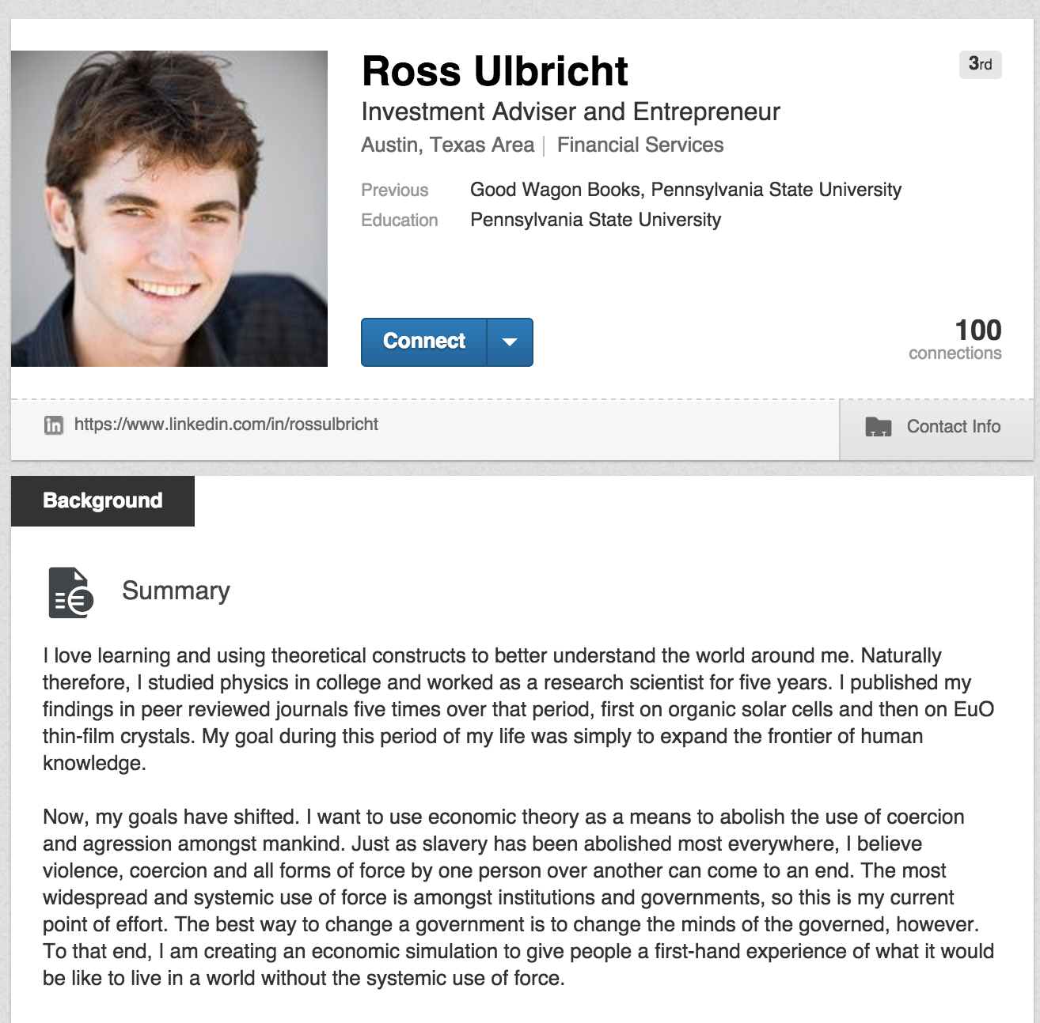
This is current!
https://www.linkedin.com/in/rossulbricht
My goal during this period of my life was simply to expand the frontier of human knowledge.
Now, my goals have shifted. I want to use economic theory as a means to abolish the use of coercion and agression amongst mankind. … To that end, I am creating an economic simulation to give people a first-hand experience of what it would be like to live in a world without the systemic use of force.

Slide 32
Silk Road Transactions

Slide 33
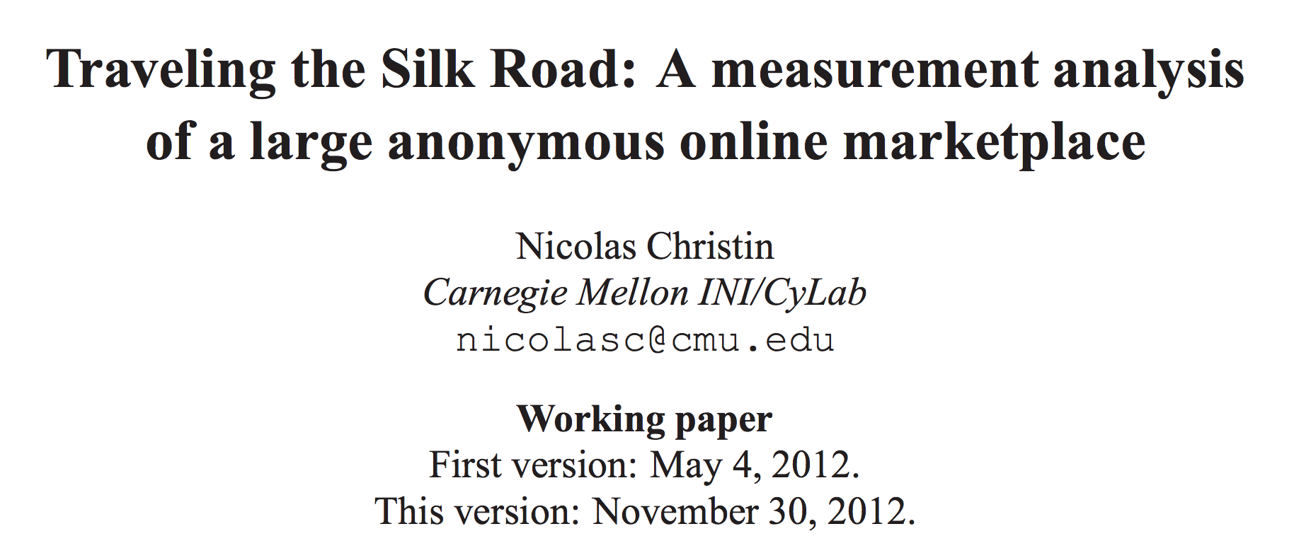
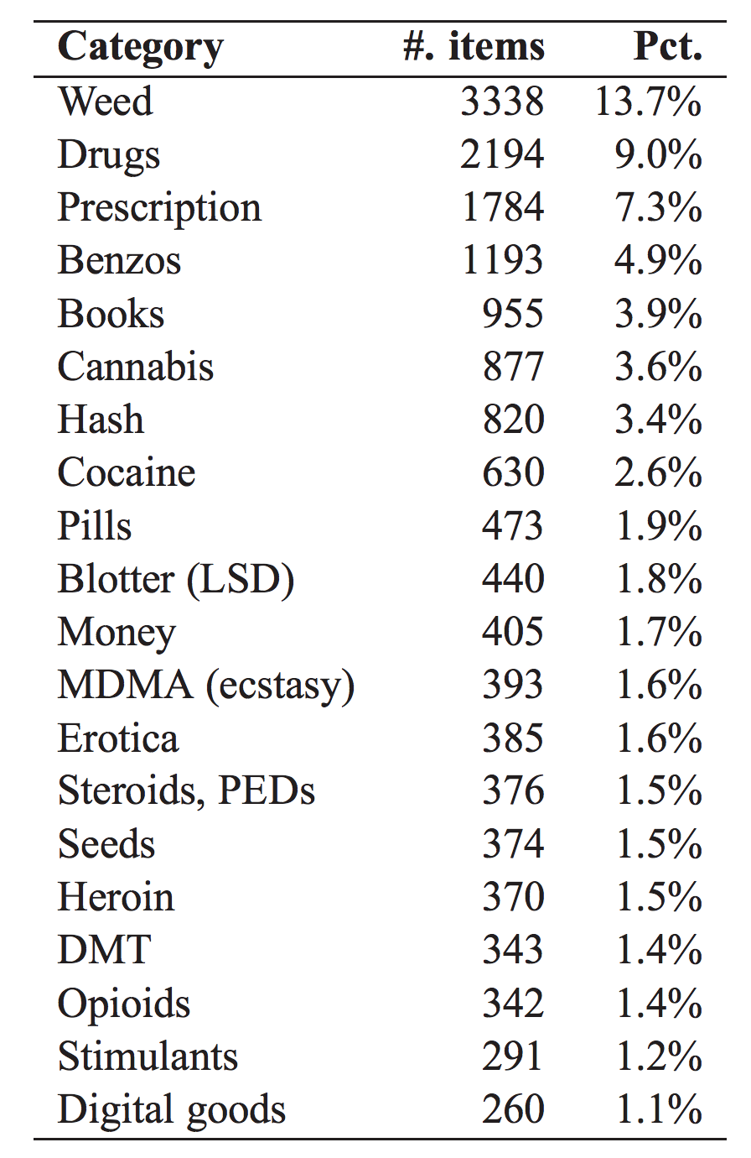

Slide 34
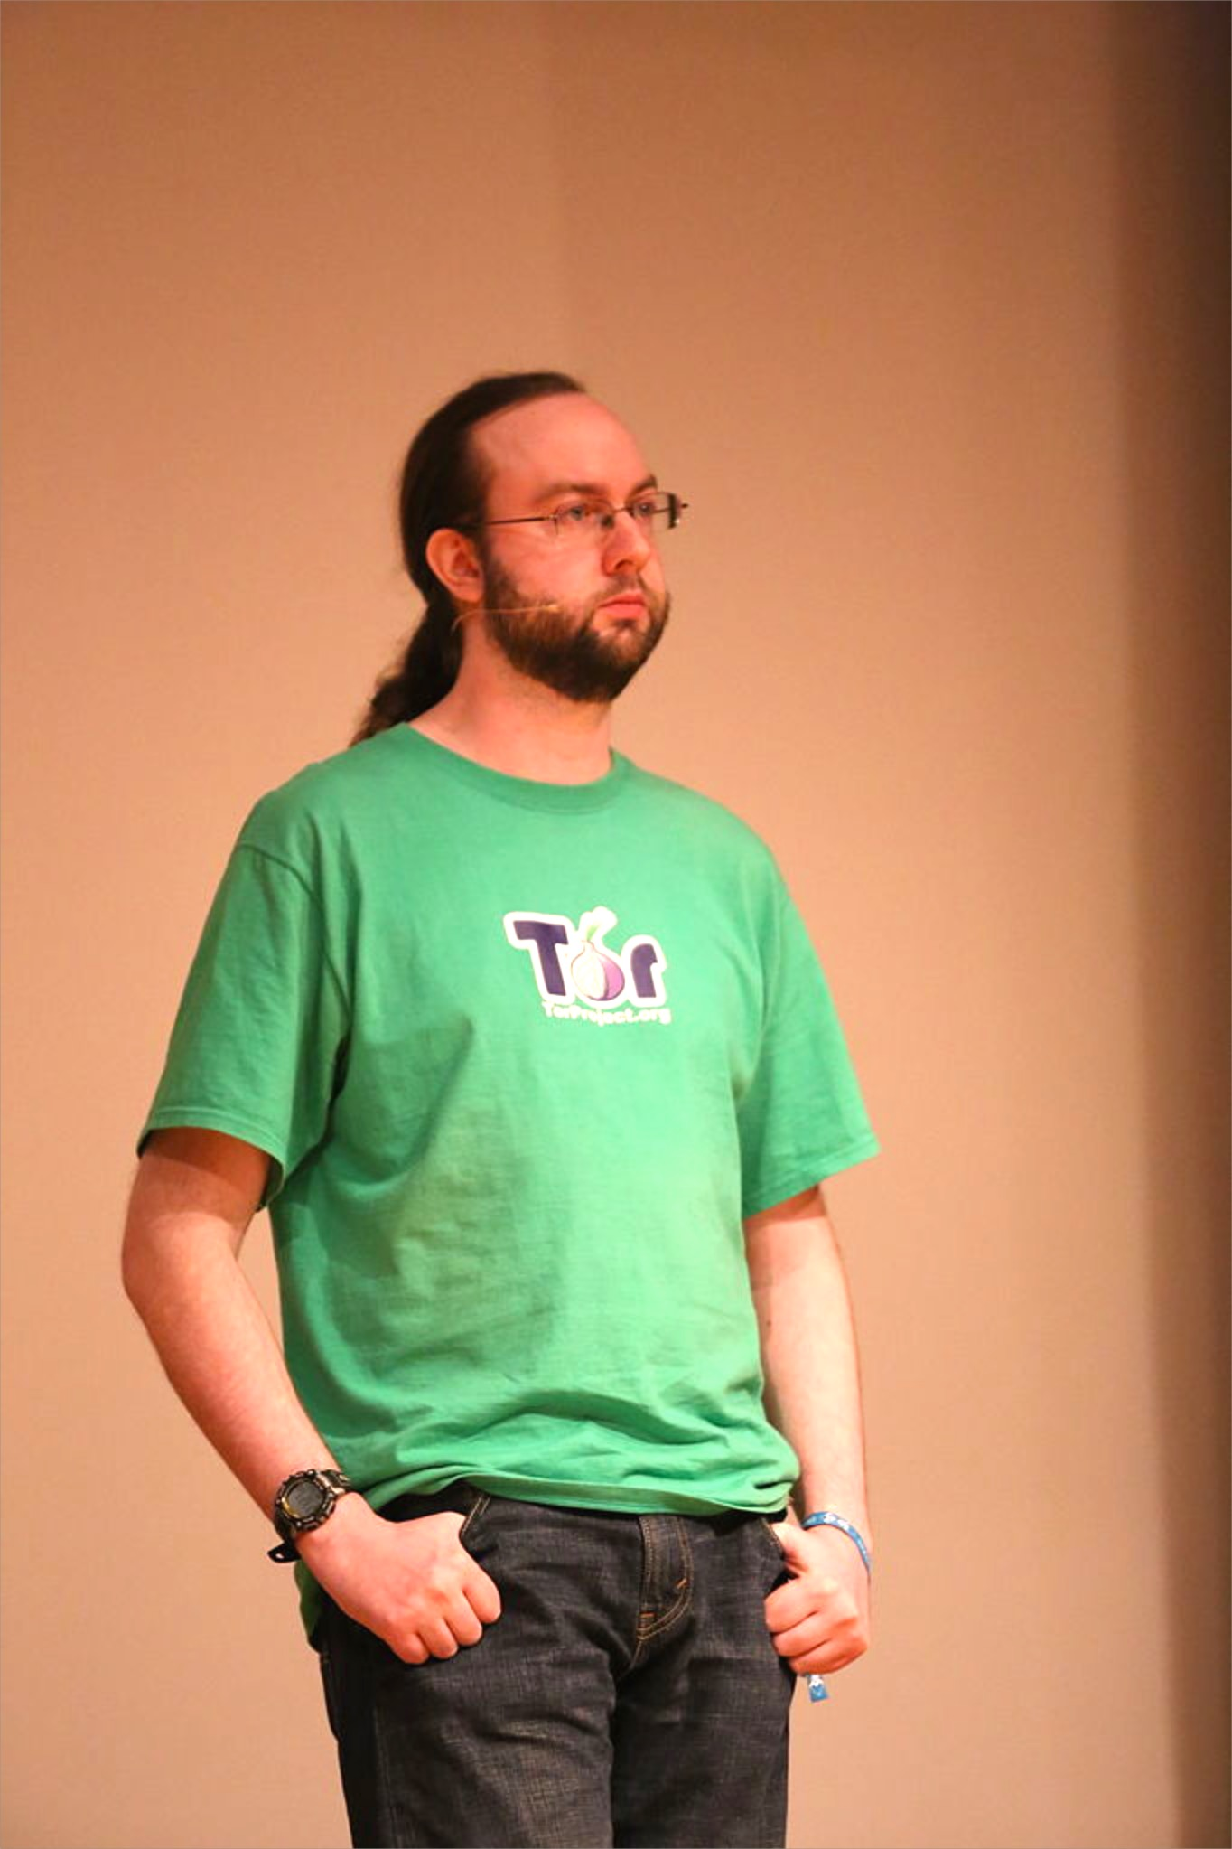
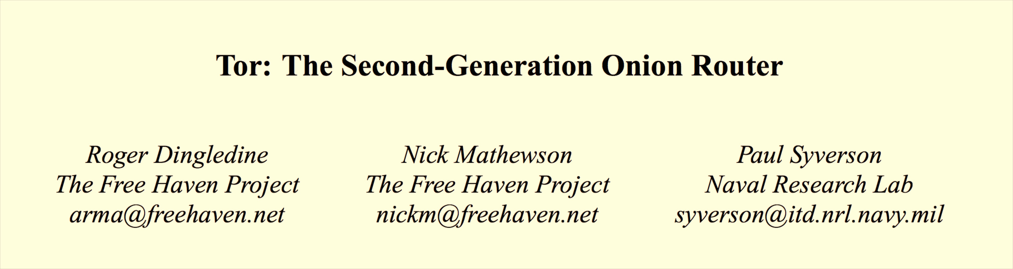

USENIX Security 2004

Slide 35
Onion Routing

Slide 37
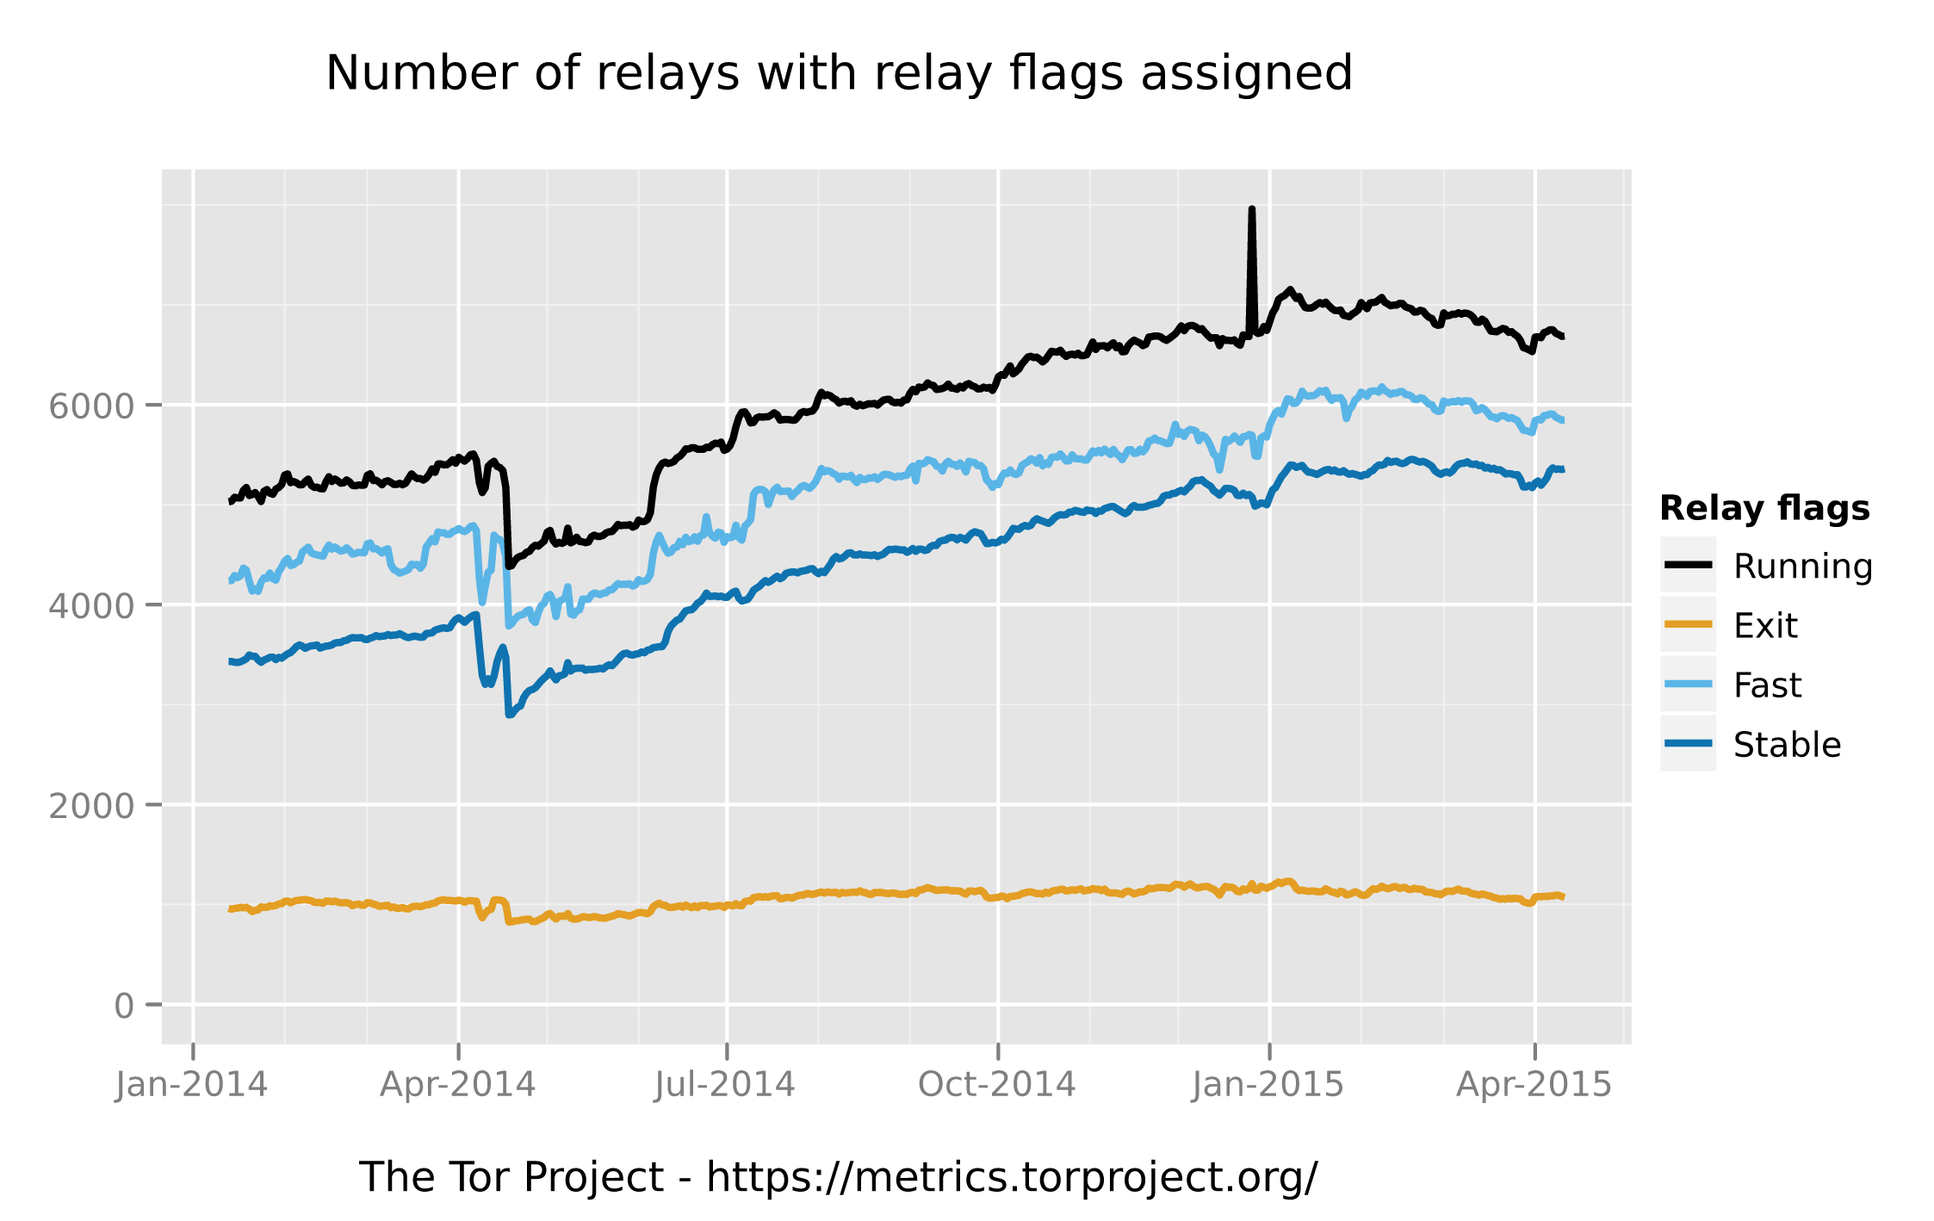

Slide 38
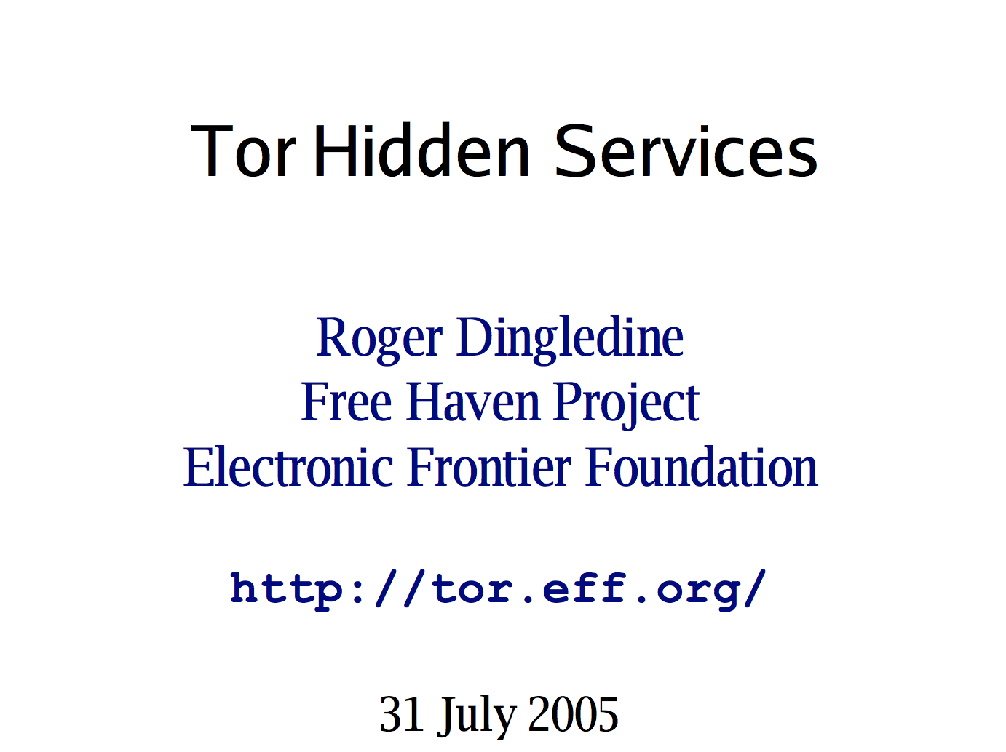
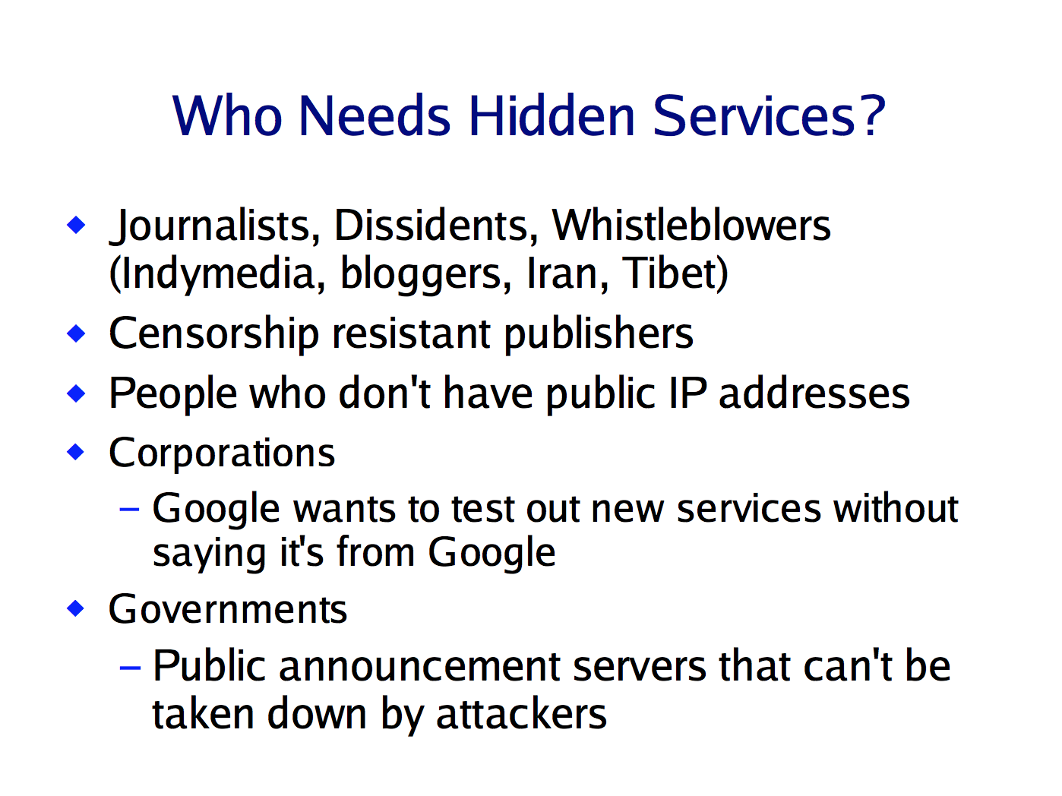

Slide 39
address = first 10 bytes of H(public)
Generate key pair
silkroadvb5piz3r.onion
facebookcorewwwi.onion
private
public

Slide 40
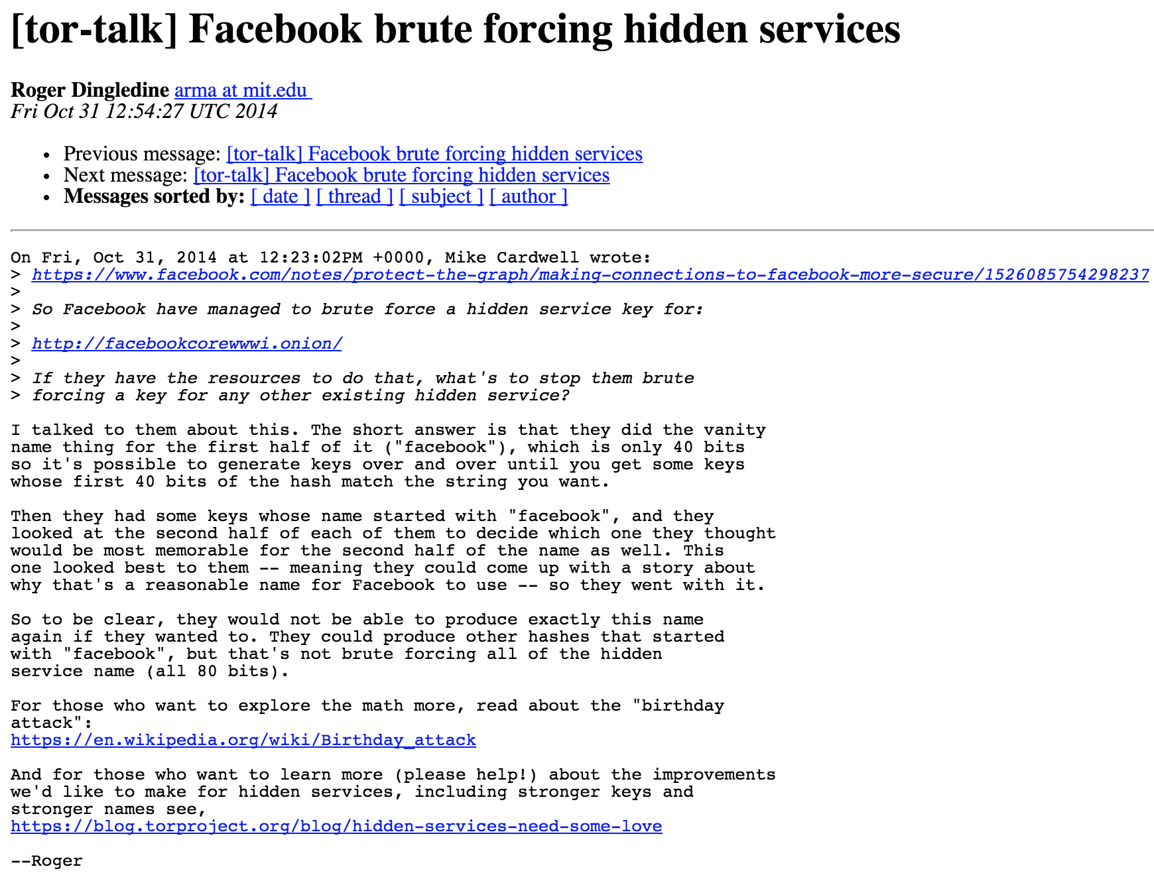
address = first 10 bytes of H(public)
Generate key pair
silkroadvb5piz3r.onion
facebookcorewwwi.onion
private
public

Slide 41
Hidden Server
Tor Link
Generate key pair
Introduction Point (Tor Relay)
private
public

Slide 42
Hidden Server
Directory Service
Tor Link
Generate key pair
Introduction Point (Tor Relay)
private
public

Slide 43
Hidden Server
2
Directory Service
Tor Link
Introduction Point (Tor Relay)
1
3
Client

Slide 44
Hidden Server
2
Directory Service
Tor Link
Introduction Point (Tor Relay)
1
3
Client
Rendezvous Point
(selected by Client)
4

Slide 45
Hidden Server
2
Directory Service
Tor Link
Introduction Point (Tor Relay)
1
3
Client
5
Rendezvous Point
(selected by Client)
4

Slide 46
Hidden Server
2
Directory Service
1
Tor Link
Introduction Point (Tor Relay)
3
Client
6
5
Rendezvous Point
(selected by Client)
4

Slide 47
Hidden Server
2
Directory Service
1
Tor Link
Introduction Point (Tor Relay)
3
Client
6
5
channel between client and server,
both only learn Rendezvous Point IP
4
Rendezvous Point
(selected by Client)

Slide 48
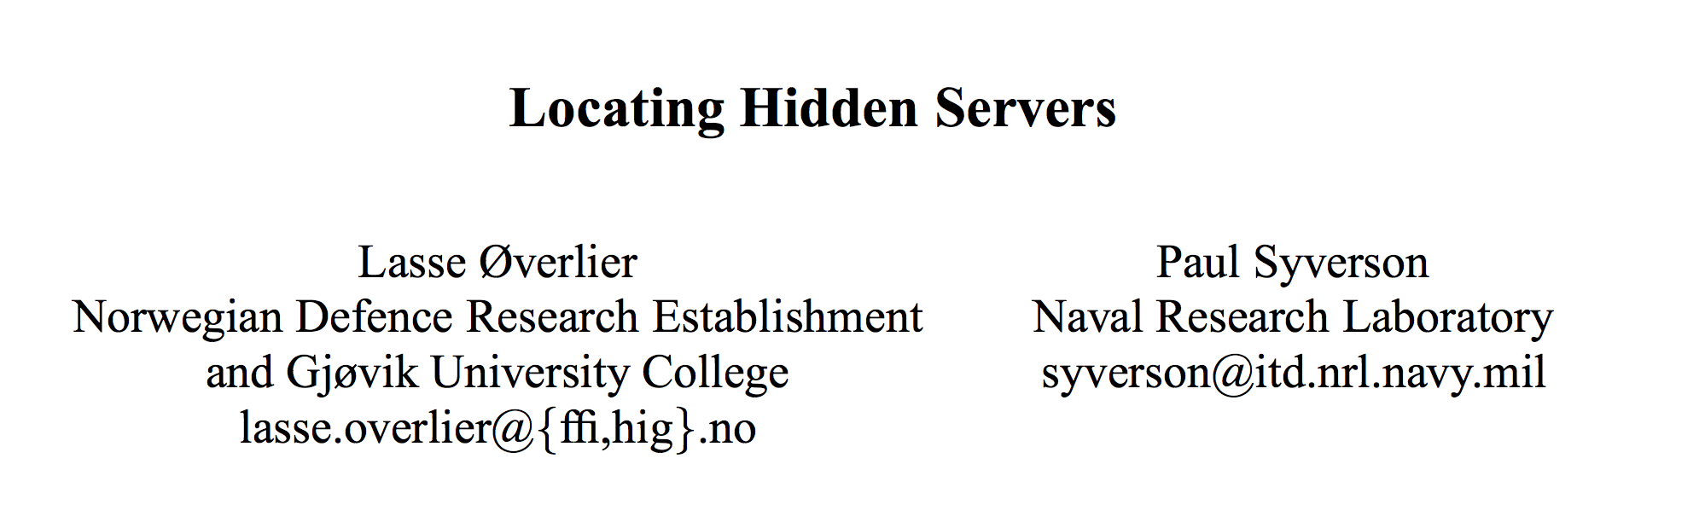
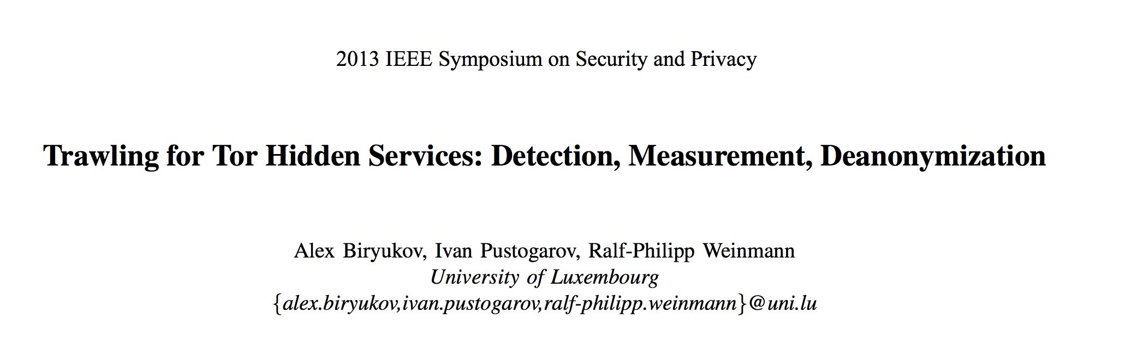
IEEE Security and Privacy 2006

Slide 49
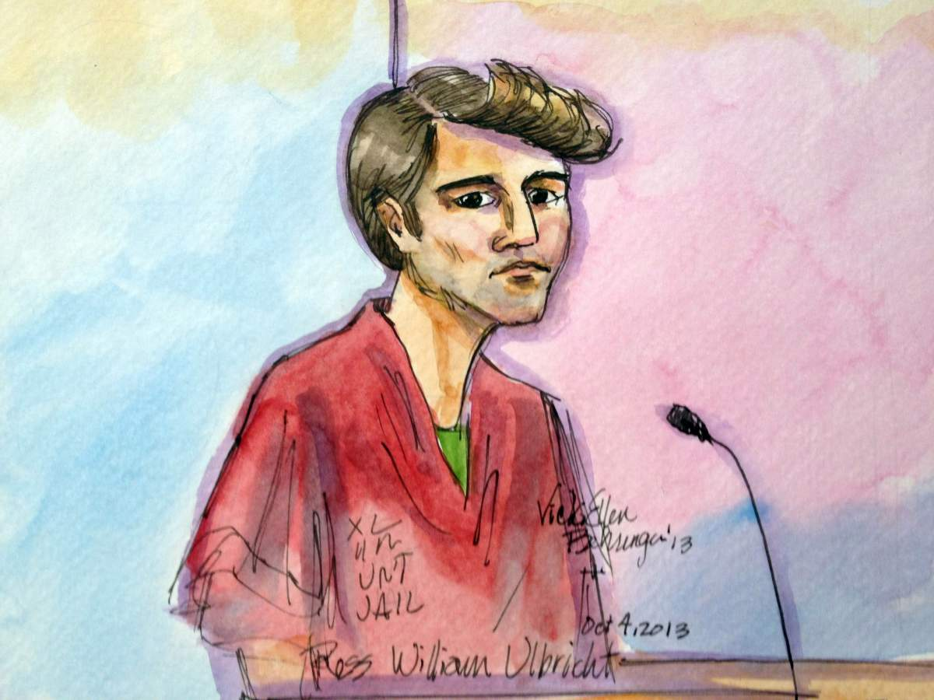
How did the FBI find the Silk Road Server?

Slide 50
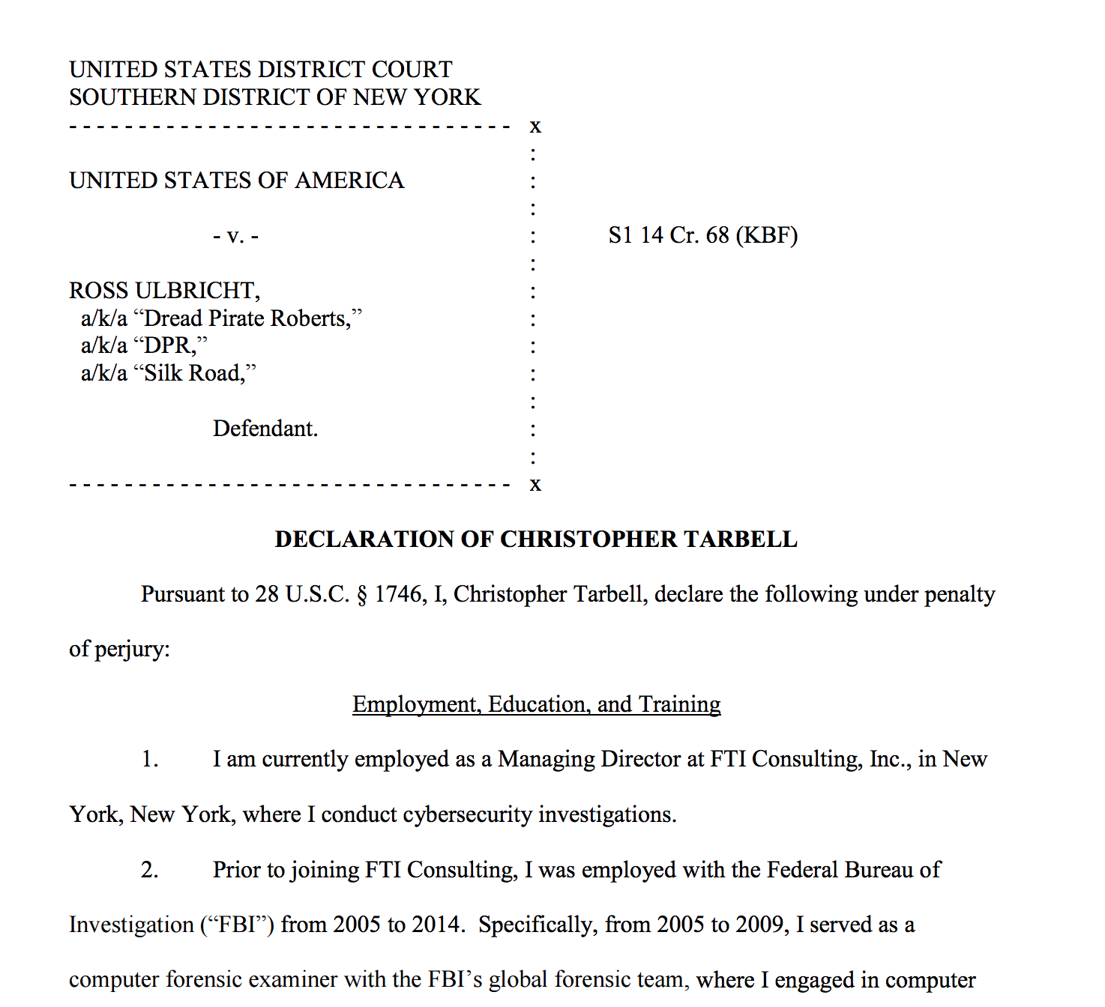

Slide 51
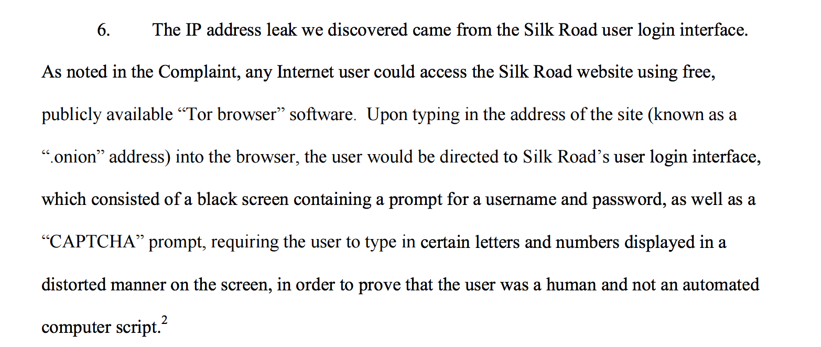
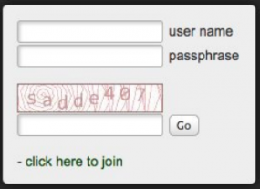

Slide 52
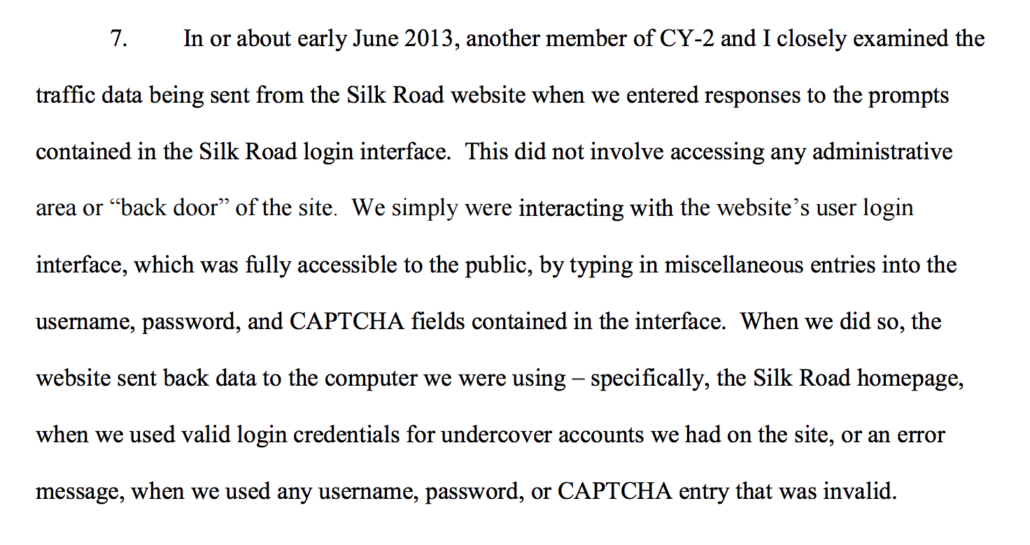

Slide 53
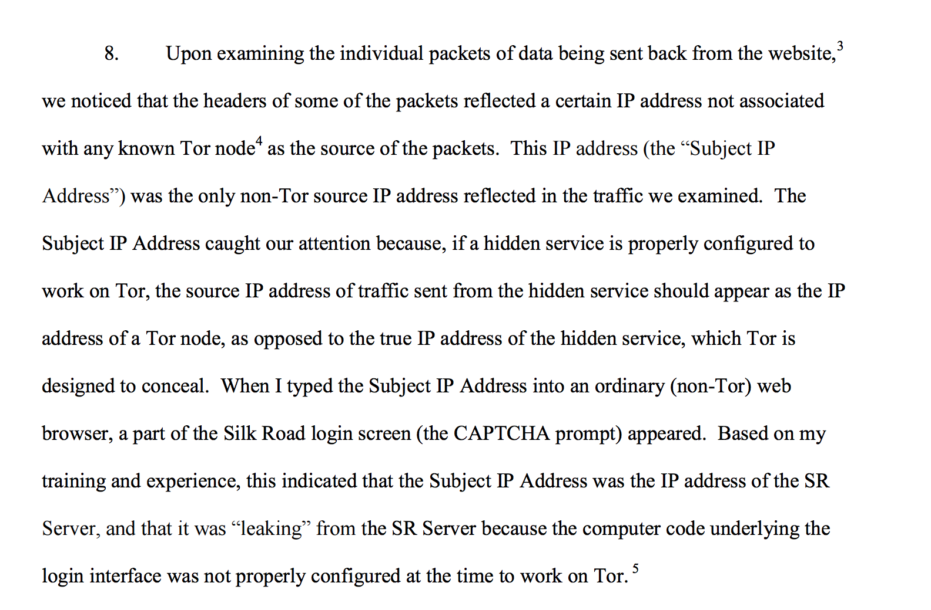

Slide 54
Architecture of Silk Road

Slide 55
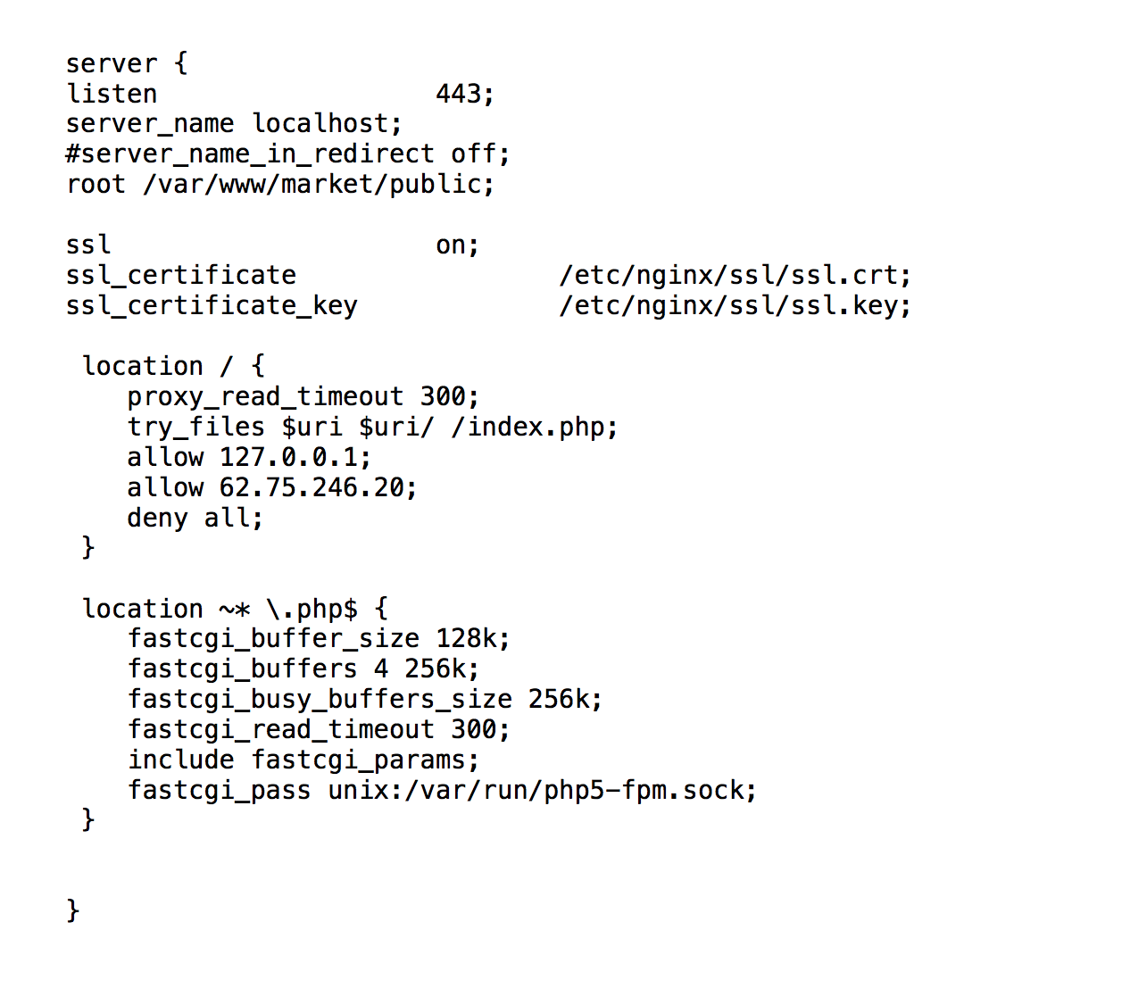
Back end server configuration:
(released by FBI)

Slide 56
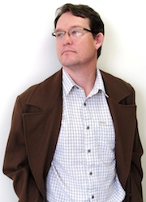
“I find it surprising that when given the chance to provide a cogent, on-the record explanation for how they discovered the server, they instead produced a statement that has been shown inconsistent with reality, and that they knew would be inconsistent with reality. Let me tell you, those tin foil hats are looking more and more fashionable each day.”
Nicholas Weaver (UC Berkeley)

Slide 57
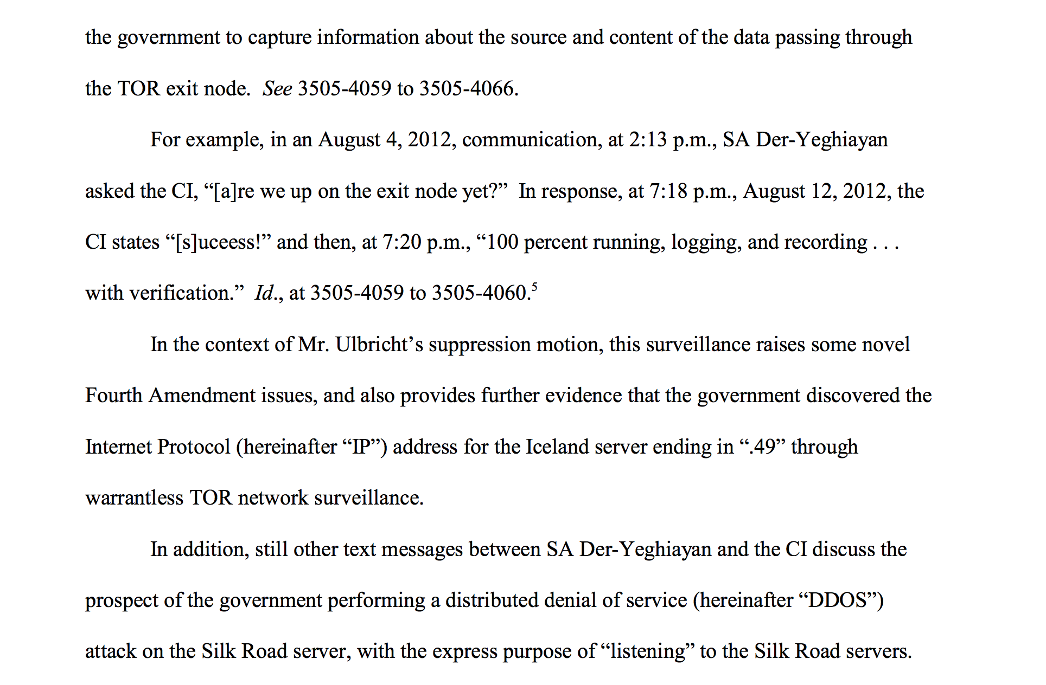

Slide 58
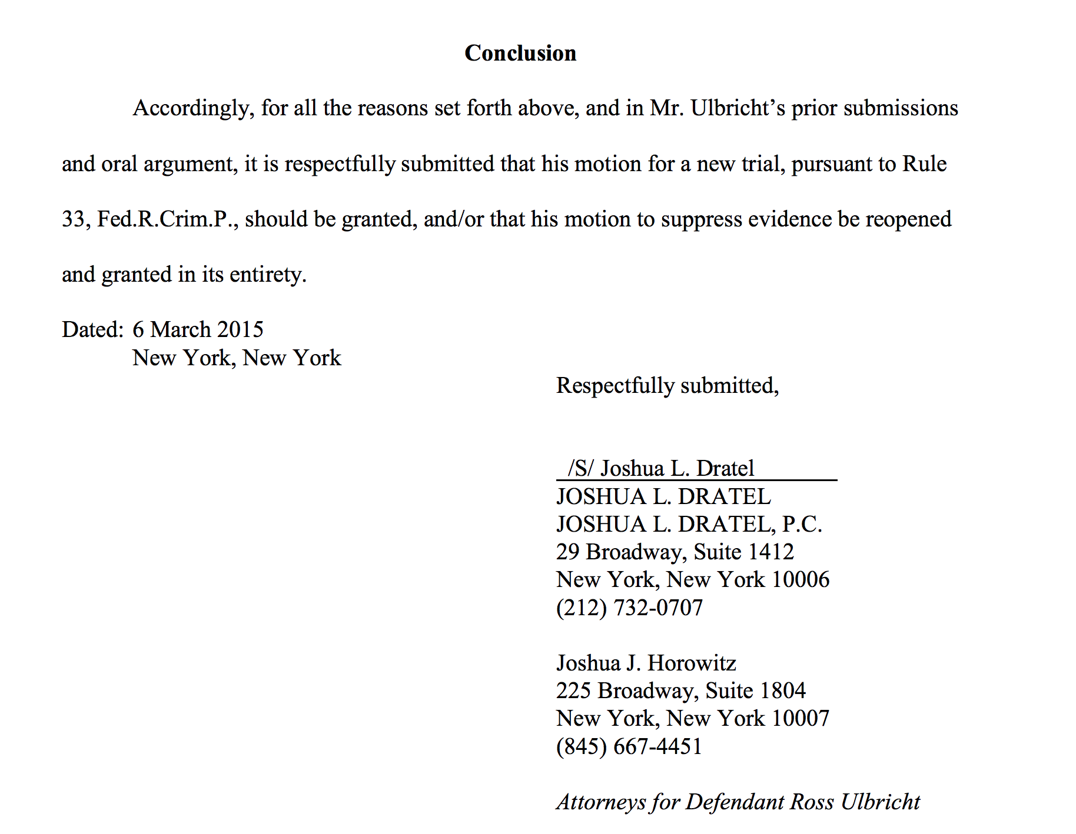

Slide 59
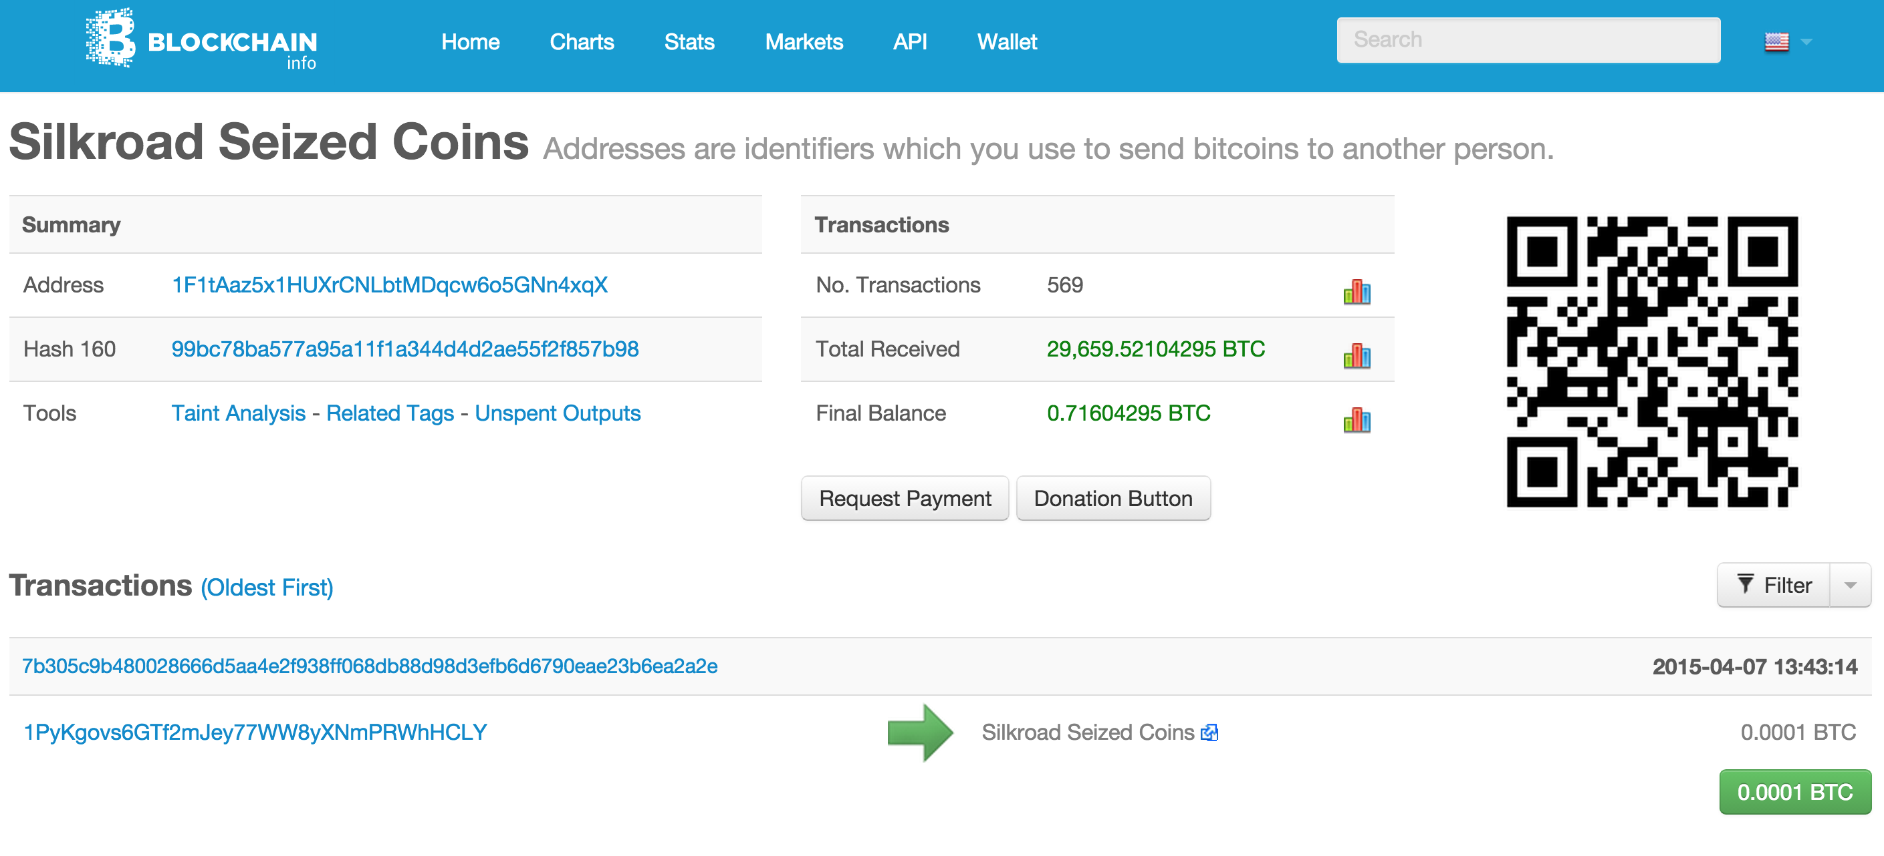
https://blockchain.info/address/1F1tAaz5x1HUXrCNLbtMDqcw6o5GNn4xqX

Slide 60
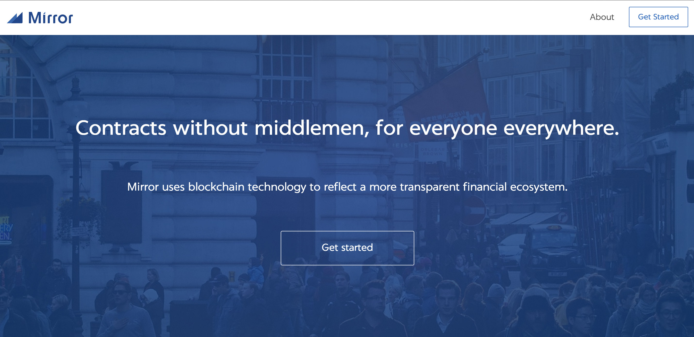
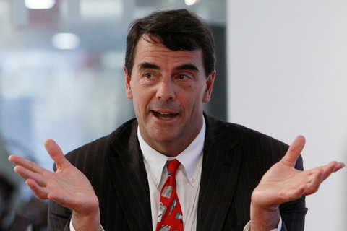
https://blockchain.info/address/1F1tAaz5x1HUXrCNLbtMDqcw6o5GNn4xqX
Tim Draper (VC) ~$19M?

Slide 61
Charge
Projects should be making good progress now!
Project Presentations will be April 20, 22 and 27.
Schedule posted on course site

